Slide 1
Algorithms

Slide 2
Fibonacci
int fib (int n){
if(n<=1)
return n;
return fib(n-1)+fib(n-2);
}

Slide 3
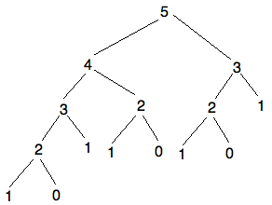
Recursive Tree

Slide 4
Caching
Storing values we have already computed
We NEVER want to compute something we have already computed
Store the values, it will save time

Slide 5
Caching
0
1
2
3
4
5
void fib(int n, int* cache){
if(n<=1)
cache[n]=n;
else{
fib(n-1, cache);
cache[n]=cache[n-1]+cache[n-2];
}
}

Slide 6
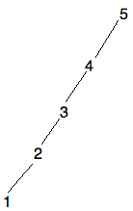
Recursive Tree

Slide 7
Dynamic Programing
Taking a recursive solution and making it iterative
Typically start with the base case and work up

Slide 8
Dynamic Programing
void fib(int n, int* cache){
if(n<=1)
cache[n]=n;
else{
fib(n-1, cache);
cache[n]=cache[n-1]+cache[n-2];
}
}
0
1
2
3
4
5

Slide 9
Dynamic Programing
void fib(int n, int* cache){
cache[0]=0;
cache[1]=1;
for(int i=2; i<=n; i++)
cache[i]=cache[n-1]+cache[n-2];
}
0
1
2
3
4
5

Slide 10
Dynamic Programming
Usually does not change the complexity but saves stack space from recursion.
Also avoids the overhead of pushing and popping the parameters.

Slide 11
Looking at Memory
void fib(int n, int* cache){
cache[0]=0;
cache[1]=1;
for(int i=2; i<=n; i++)
cache[i]=cache[n-1]+cache[n-2];
}

Slide 12
Memory
The cache has n memory complexity.
In this case, the current computation only requires the results from the last two. We can then only use two variables, rather than an array of them.

Slide 13
Fibonacci
int fib(int n){
int n_2=0, n_1=1, result=0;
for(int i=2; i<=n; i++){
result=n_2+n_1;
n_2=n_1;
n_1=result;
}
return result;
}

Slide 14
Memory
Now what is the memory complexity?

Slide 15
Memory
Now what is the memory complexity?
2, so constant

